Slide 1
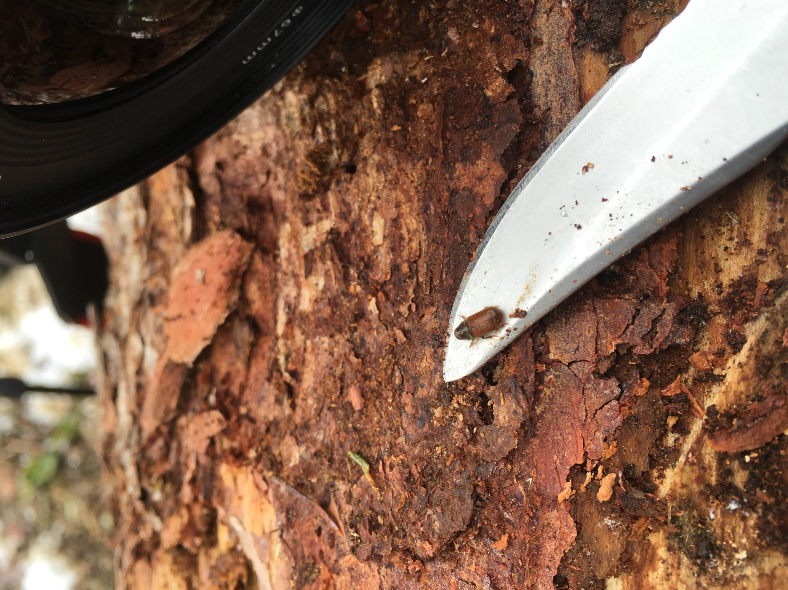
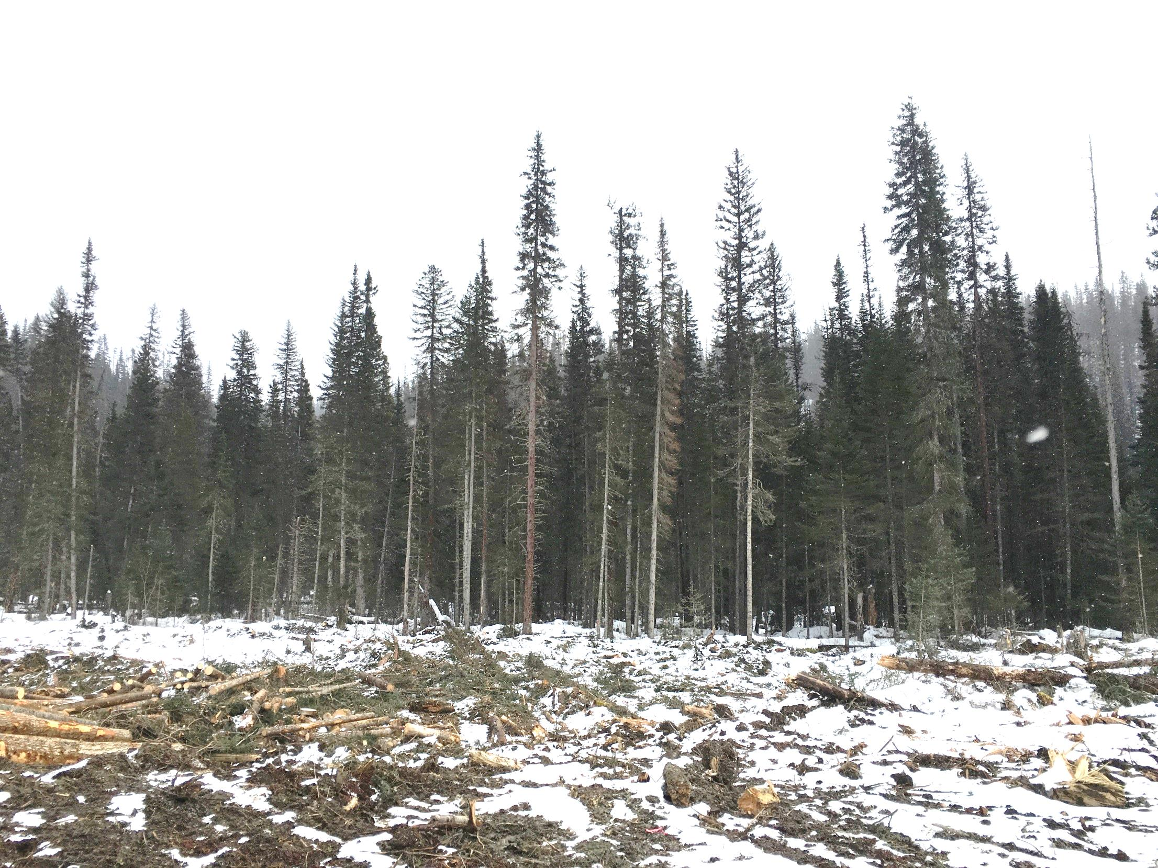
Spruce beetle
Jeanne Robert, PhD – original author
Regional Forest Entomologist
Omineca and Northeast
Dean Christianson, RPF
Stewardship (Forest Health) Forester
Selkirk Natural Resource District

Slide 2
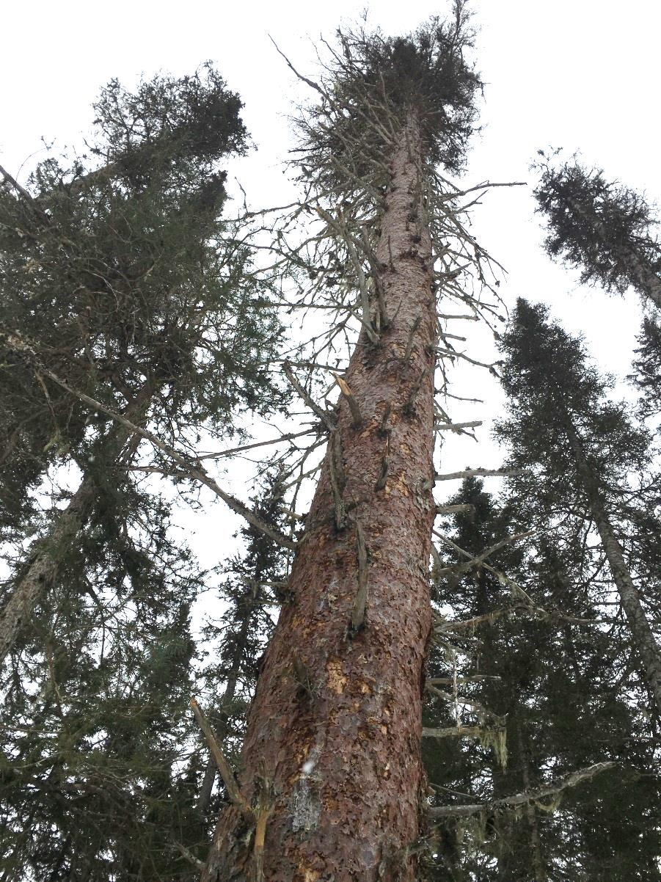
Where are we now?
  Why spruce beetle?
  Why is it still going?
  What are we doing?
Notes:
Bark beetles in general over the last decade have become a primary influence on where, when and how much we harvest across the province. Hopefully this presentation will give you a glimpse of what some of the factors are that forest professionals consider when managing our forests and this current outbreak.

Slide 3
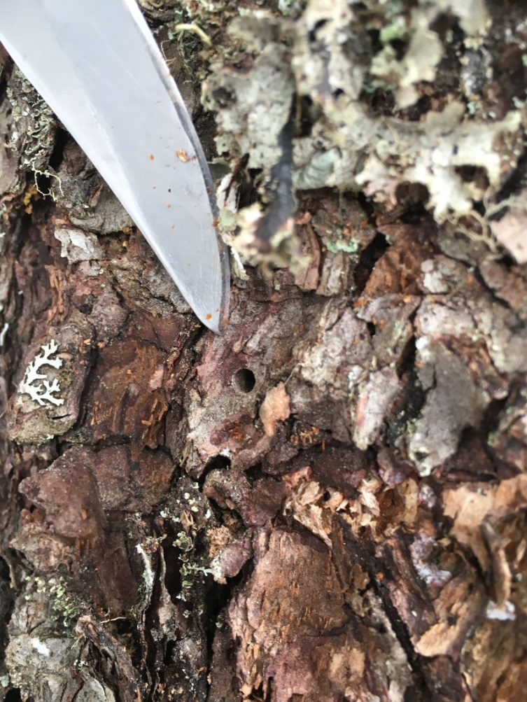
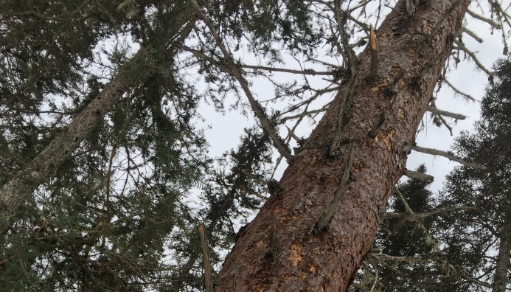
Why spruce beetle?
2 winters are tough!
40-60% of immature adults emerge and overwinter in the duff
Warm blanket of snow and no woodpeckers
Early / late cold snaps

Slide 4
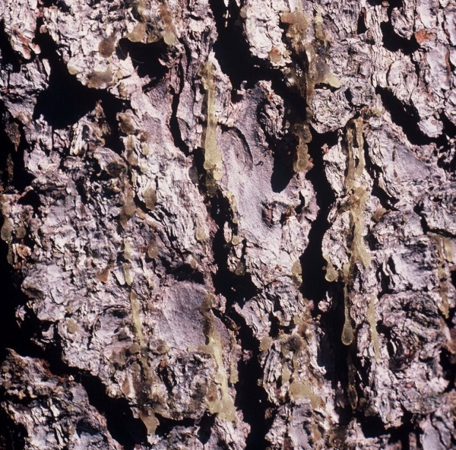
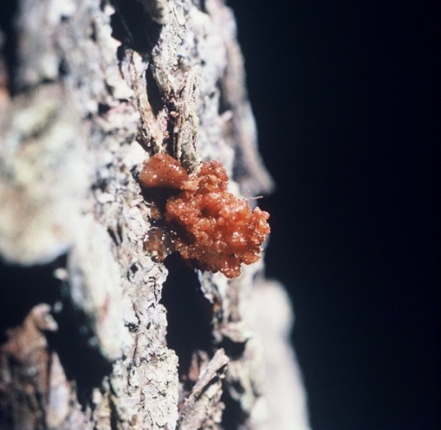
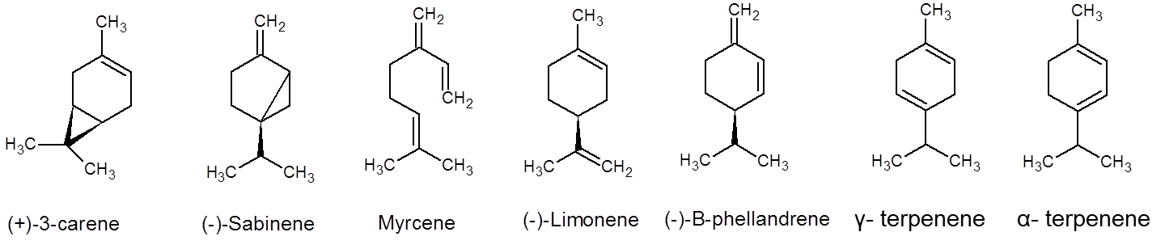

Why spruce beetle?
Host trees are tough!
Healthy trees are well defended
Spruce beetles are normally relegated to weakened or dying trees

Slide 5
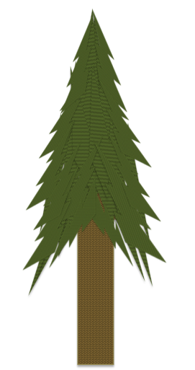
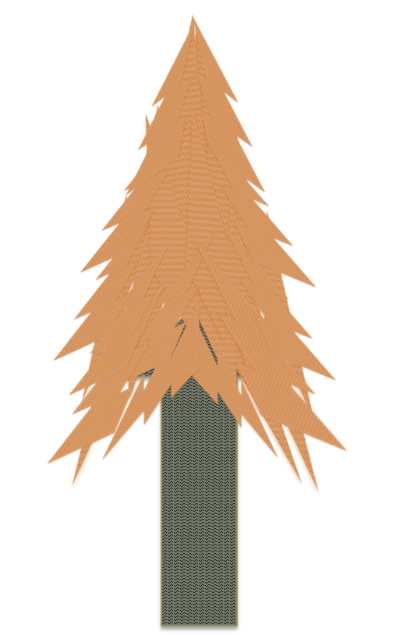




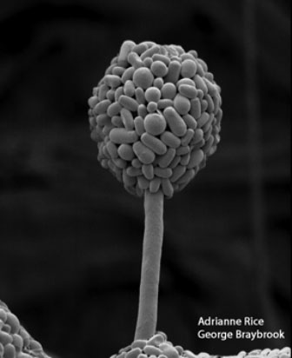




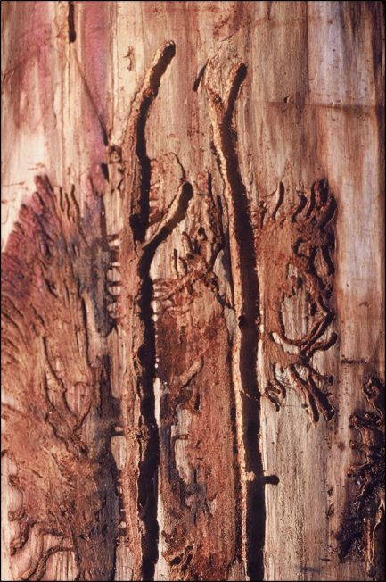



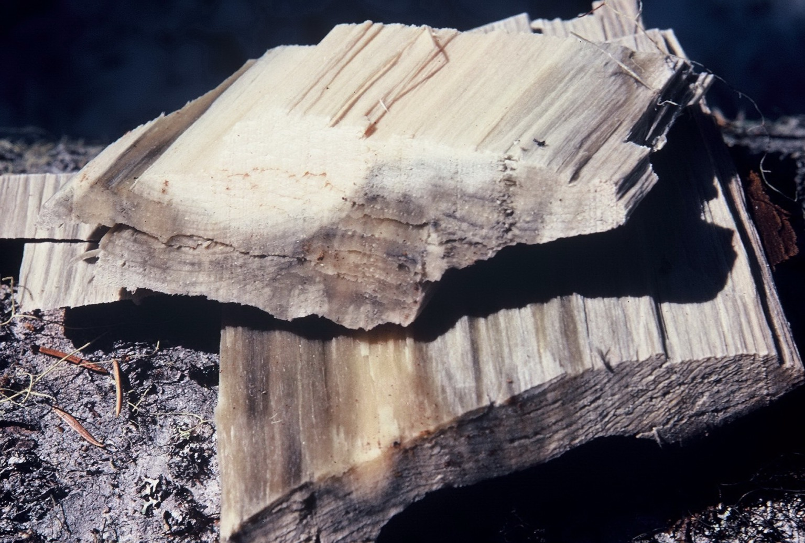
Why spruce beetle?
Allies: blue stain fungi
http://genomealberta.ca/blogs/main_05090801.aspx

Slide 6
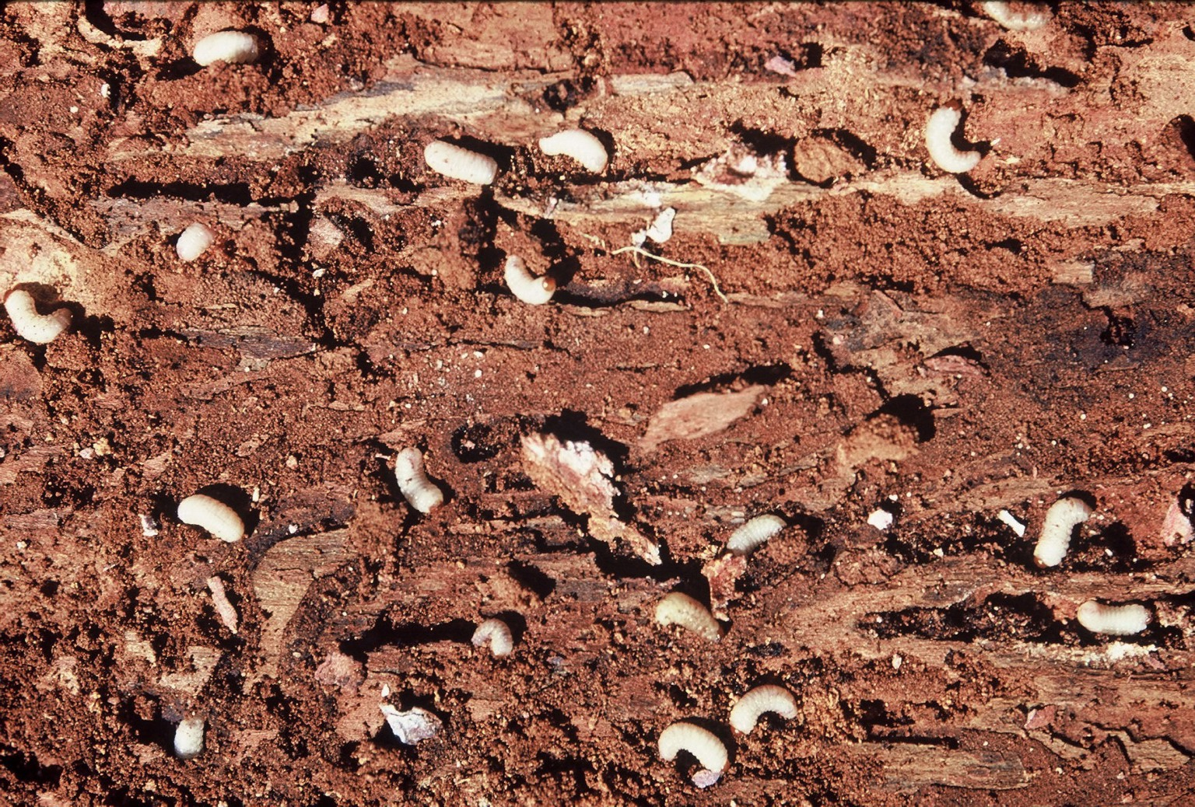


Why spruce beetle?
Allies: mass attack

Slide 7











Why spruce beetle?
Allies: warmer temperatures

Slide 8

Why spruce beetle?
Lets increase the temperature

Slide 9
Why spruce beetle?
life cycle: one year

Slide 10
IBS
2015 – 106 ha Revelstoke, 1070ha Golden, Total of 453 ha in Mod & Sev polys
2016 – 720 ha Revelstoke, 2106 ha Golden, Total of 1340 ha in Mod & Sev polys
2017 – 622 ha Revelstoke, 3201 ha Golden, Total of 2469 ha in Mod & Sev polys
Populations still rising, 40-65% of area in Moderate or Severe Polygons, % is rising each year
Notes:
Aerial Overview Survey is a snap shot in time of what new attack can be detected from the air (red or fading trees). It does not consider previous years attack.
Categories: Trace(<1%), Low (1-10%),Moderate (11-29%), Severe (30-49%), Very Severe (50+%)
Revelstoke 2017 AOS (ha): T=41; L=548; M=31; S=2
Golden 2017 AOS (ha): T=0; L=454; M=2264; S=483

Slide 11
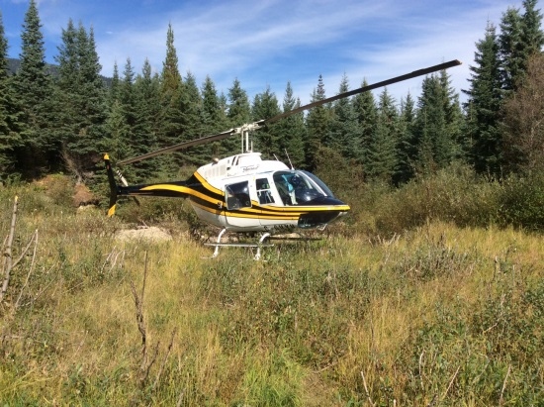
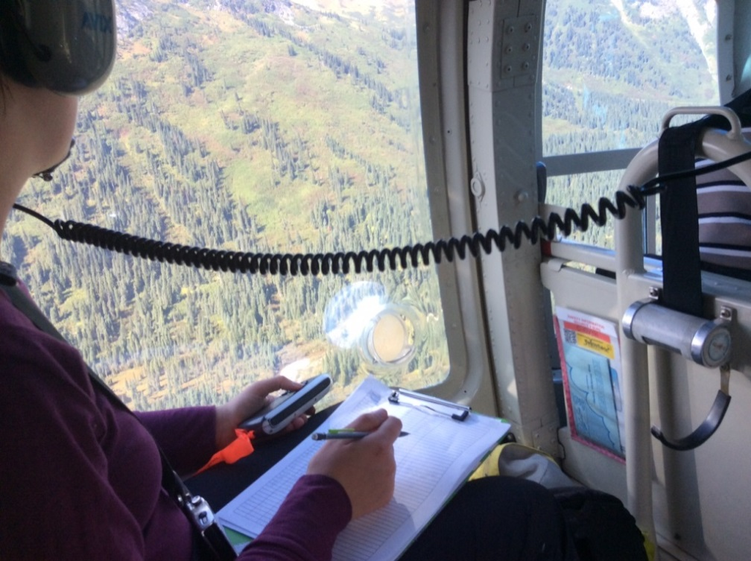
How do we know?
Spruce Beetle Monitoring Program
Aerial Overview Surveys (AOS)
Low-level Helicopter Surveys

Slide 12
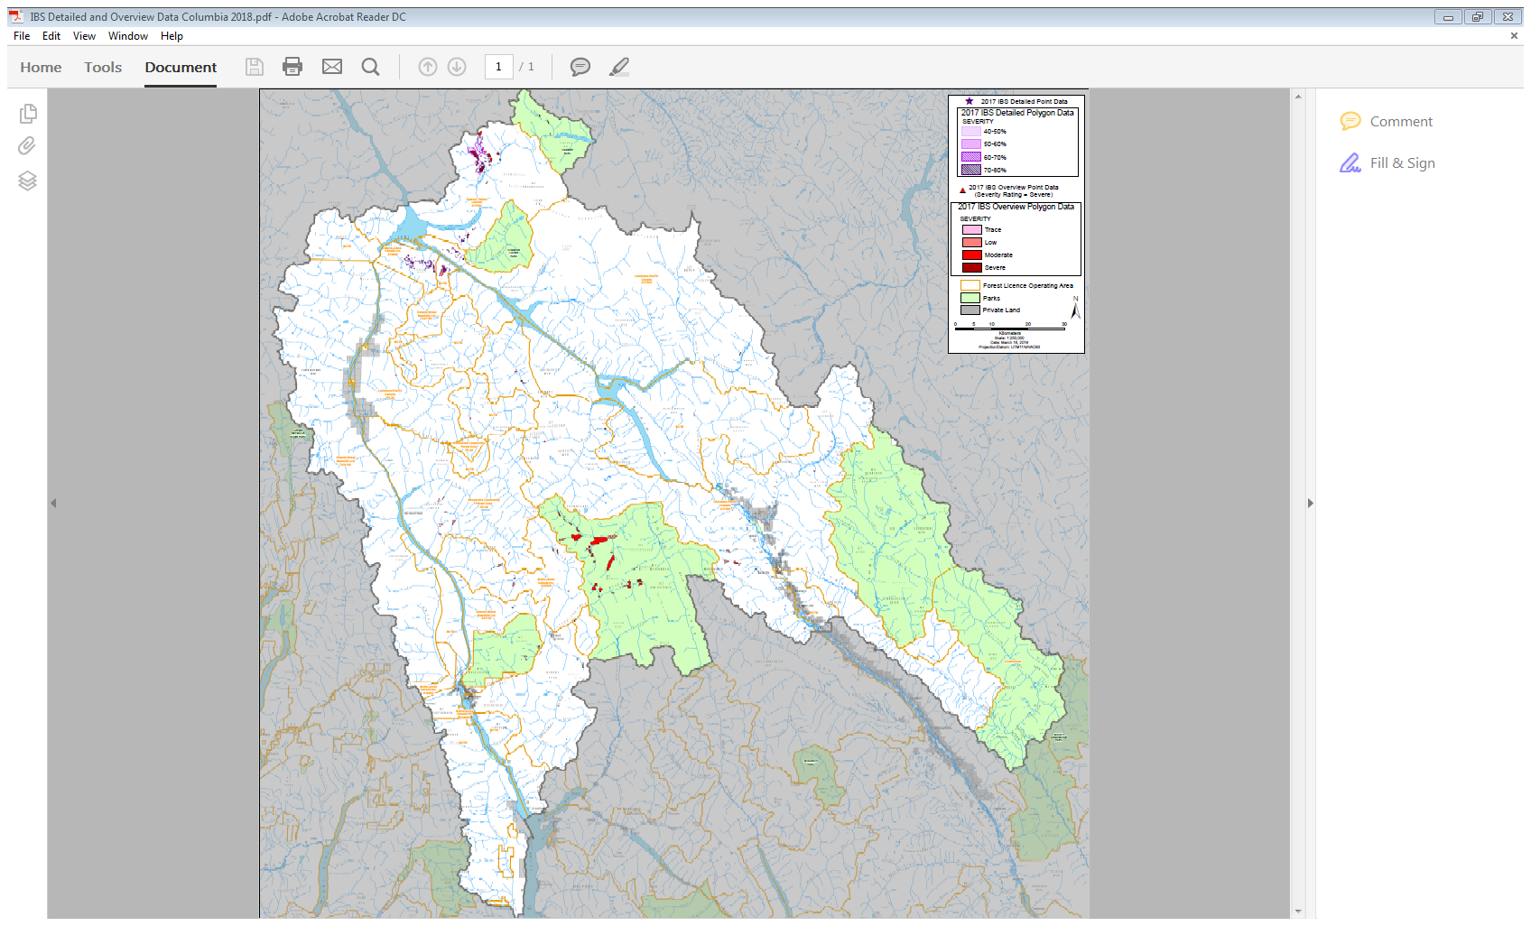
http://www.arcgis.com/home/webmap/viewer.html?webmap=e5285cdbe1c94668aa1688cc90732d0b
Notes:
ADD NEW MAP showing more area adj to RV

Slide 13
IBD
2015–121 ha Revelstoke,103 ha Golden, Total of 122 ha in Mod & Sev polys
2016–211 ha Revelstoke, 274 ha Golden, Total of 295 ha in Mod & Sev polys
2017–891 ha Revelstoke, 245 ha Golden, Total of 550 ha in Mod & Sev polys
Populations still rising, 48-61% of area in Moderate or Severe Polygons, % is lowest in 2017, Largest increase in Revelstoke.
Notes:
Aerial Overview Survey is a snap shot in time of what new attack can be detected from the air (red or fading trees). It does not consider previous years attack.
Categories: Trace(<1%), Low (1-10%),Moderate (11-29%), Severe (30-49%), Very Severe (50+%)
Revelstoke 2017 AOS (ha): T=57; L=436; M=301; S=97
Golden 2017 AOS (ha): T=0; L=95; M=113; S=38

Slide 14
Management Strategies
Sanitation Harvest (need to remove 80%+ of attack within 1 year to maintain suppression within a BMU)
Blowdown & fire damaged removal
Trap Trees & Funnel Traps
Salvage Harvest

Slide 15
What are we doing?
Sharing Information
Provincial annual Aerial Overview Survey (AOS) posted at: ftp://ftp.for.gov.bc.ca/HFP/external/!publish/Aerial_Overview/
Selkirk District detailed and AOS information on FTP site: https://www.for.gov.bc.ca/ftp/DAB/external/!publish/Forest%20Health/

Slide 16
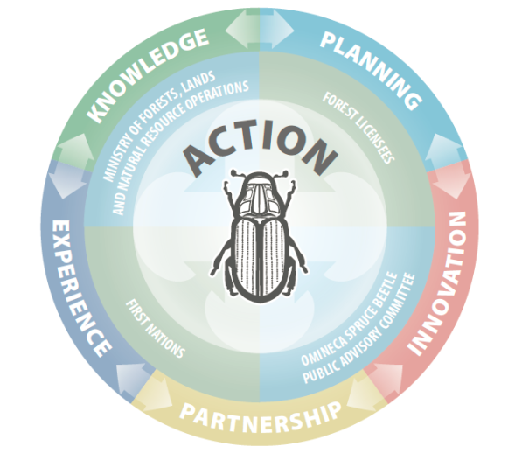
What do we need to do?
Working together for balance
  Reduce Non-recoverable losses and protect future timber supply
  Maintain Ecosystem function and non-timber values
Collaborative approach
  Joint licensee-FLNRORD TSA spruce beetle working groups - Needed?
    Share operational information and best practices (e.g. retention guidance)
    Licensee Action Plan and Reporting
    Sanitation Harvest Focus
    Familiarize yourselves with Forest Health Strategies for your TSA

Slide 17
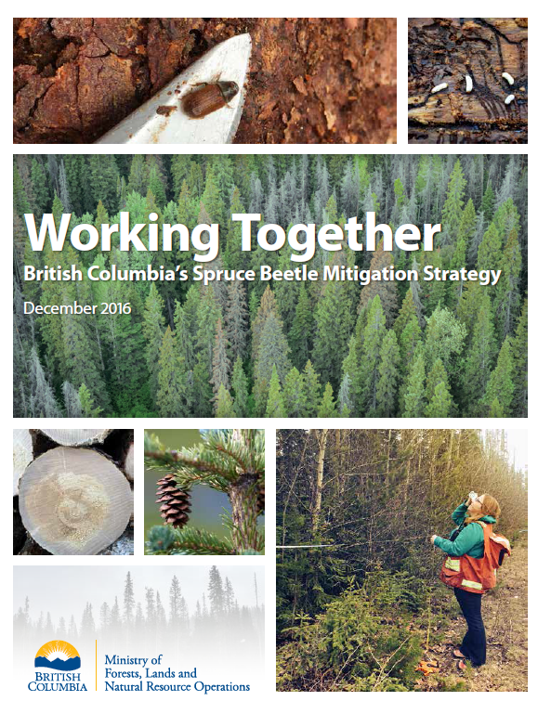
Google: Omineca Spruce Beetle
(good data source)
https://
www2.gov.bc.ca/gov/content/industry/forestry/managing-our-forest-resources/forest-health/forest-pests/bark-beetles/spruce-beetle/omineca-spruce-beetle
Contacts: Dean Christianson, DSE Stewardship – Forest Health Forester
Marnie Duthie-Holt, RKB Entomologist

